Slide 1
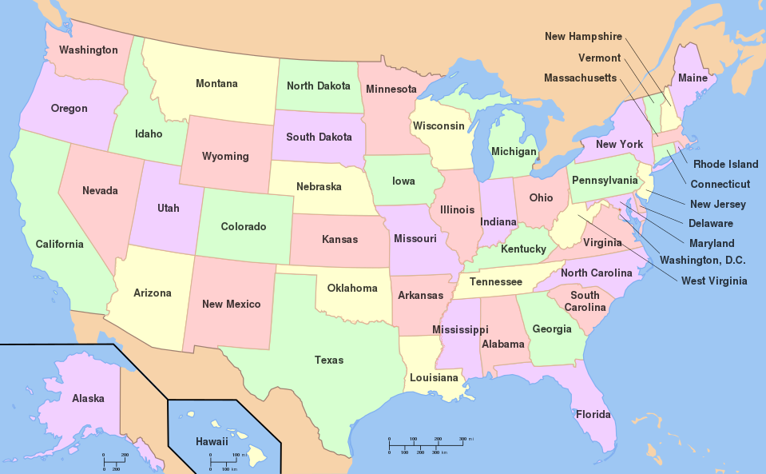
Natural Locations

Slide 2
Man-Made Locations

